Slide 1
Neural Network Implementation and Analysis
Exploring ANN and CNN with PyTorch and Keras
Moiz asif(sp23-bai-026),Muhammad hammad(sp23-bai-034)

Slide 2
DATASET DESCRIPTION:
CLASSFICATION (MNIST):
The MNIST dataset contains 70,000 grayscale images of handwritten digits (0-9), each sized 28x28 pixels. It is split into 60,000 training samples and 10,000 test samples, with labels for 10 classes. The data is normalized to the range [0, 1] and reshaped to (28, 28, 1) for CNN input. This dataset is widely used for benchmarking both artificial neural networks (ANNs) and convolutional neural networks (CNNs).
Regression (): The White Wine Quality Dataset consists of 4,898 samples with 11 numerical features representing physicochemical properties of white wines, such as acidity, residual sugar, alcohol, and pH. The target variable, quality, is an integer score (0–10) representing wine quality. The dataset was split into 80% training data (~3,918 samples) and 20% test data (~980 samples) , with 10% of the training data used as a validation set (~392 samples). This dataset is used for a regression task to predict wine quality based on its features.

Slide 3
Model Details
PyTorch ANN Models: For classification, a simple ANN was implemented for the MNIST dataset with an input layer (784 neurons), three hidden layers (512, 256, 128 neurons with ReLU activation), and a 10-neuron output layer. The model achieved a validation accuracy of XX% and a test accuracy of XX%. For regression, an ANN was used on the White Wine Quality dataset with 11 input features, two hidden layers (64, 32 neurons with ReLU activation), and a single output neuron. The model achieved an MSE of XX, MAE of XX, and an R² score of XX. Training and validation losses were tracked for both tasks
Keras CNN Architecture: A CNN was implemented for MNIST classification with a convolutional layer (32 filters, 3x3 kernel, ReLU), max-pooling (2x2), a dense layer (128 neurons, ReLU), dropout (0.2), and a softmax output layer (10 classes). The model, trained for 5 epochs with Adam optimizer and categorical cross-entropy loss, achieved a test accuracy of XX% and loss of XX. Confusion matrix and learning curves were analyzed.

Slide 4
Training Configuration
ANN Classification Training Configuration:
Learning Rate: 0.001
Batch Size: 64
Number of Epochs: 10
ANN Regression Training Configuration:
Learning rate: 0.001
Batch size: 32
Number of epochs: 20
CNN Classification Training Configuration:
Learning rate: 0.001
Batch size: 32
Number of epochs: 5

Slide 5
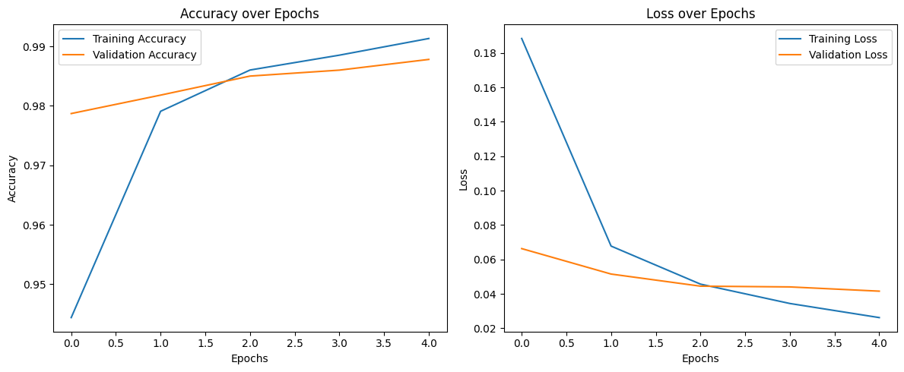
GRAPHS CNN:
CNN:

Slide 6
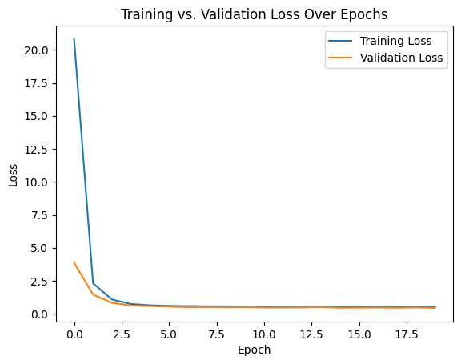
ANN (Regression)

Slide 7
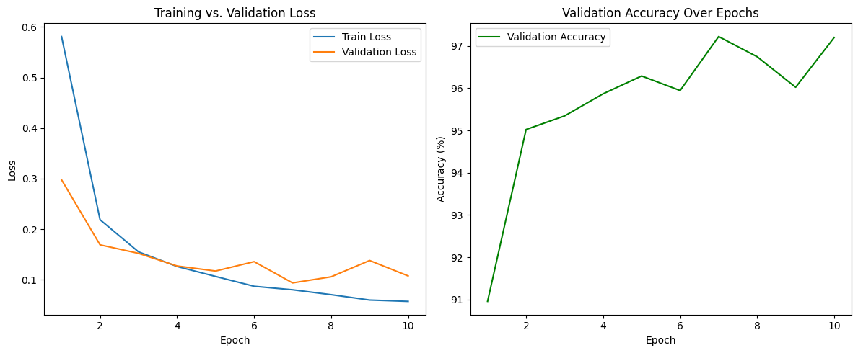
ANN (Classification)

Slide 8
COMPARISON TABLE
Model | Dataset / Task | Key Hyperparams | Final Metric | Training Time
PyTorch ANN (Reg) | White wine Quality | LR=0.001, Epoch=20 | MSE = 0.5331; MAE = 0.5706 | 35s
PyTorch ANN (Class) | MNIST | LR=0.001, Epoch=10 | Accuracy = 82.4% | ~2 min 33s
Keras CNN (Class) | MNIST | LR=0.0001, Epoch=5 | Accuracy = 88.7% | ~ 4 min 21 s

